Slide 1
Intelligent Reflecting Surface Versus Decode-and-Forward: How Large Surfaces are Needed to Beat Relaying?
E. Björnson, Ö. Özdogan and E. G. Larsson, "Intelligent Reflecting Surface Versus Decode-and-Forward: How Large Surfaces are Needed to Beat Relaying?," in IEEE Wireless Communications Letters, vol.9, no.2, pp.244-248, Feb.2020 (cited by 367)
Advisor: Dr. Kuang-Hao Liu
Presenter: Shao-Heng Chen
Date: June 15, 2022
Notes:
大家好 今天我要介紹的論文是 Intelligent Reflecting Surface Versus Decode-and-Forward: How Large Surfaces are Needed to Beat Relaying?
是2020年2月 發表於 IEEE Wireless Communications Letters 的文章 目前累積有367個citations 從論文題目我們已經可以預知到這個比較結果會是 decode-and-forward 勝出

Slide 2
Outline
1. Motivations
2. System model
3. Simulation results
1
Notes:
為什麼大小很重要? 因為大小決定pathloss
WHY size Important? the total size of the IRS determines the pathloss

Slide 3
Motivation
1. Why compare to relay scheme?
– A comparison with an ideal AF relaying was made in [1]
2. Why size matters?
– The total size of the IRS will determines the pathloss [2]
3. I think such comparison is very interesting!
[1] C. Huang, A. Zappone, G. C. Alexandropoulos, M. Debbah, and C. Yuen, “Reconfigurable intelligent surfaces for energy efficiency in wireless communication,” IEEE Trans. Wireless Commun., vol. 18, no. 8, pp. 4157–4170, Aug. 2019. (cited by 1336)
[2] O. Özdogan, E. Björnson, and E. G. Larsson, “Intelligent reflecting surfaces: Physics, propagation, and pathloss modeling,” CoRR, 2019. (cited by 307)
2
Notes:
首先是研究動機的部分 1. 為什麼要拿IRS跟relay比較? 因為IRS的運作機制很像是half-duplex relay [10] J. N. Laneman, D. N. C. Tse, and G. W. Wornell, “Cooperative diversity in wireless networks: Efficient protocols and outage behavior,” IEEE Trans. Inf. Theory, vol. 50, no. 12, pp. 3062–3080, Dec. 2004.
客觀證據是之前有其他研究者也這麼比較 如2019年那篇 AF relay that will be used for performance comparisons purposes
2. 為什麼大小很重要? 因為大小實際上會影響所受到的pathloss
3. 醬的比較相當有趣

Slide 4
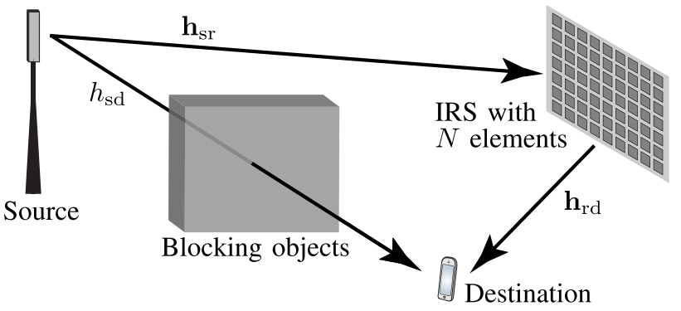
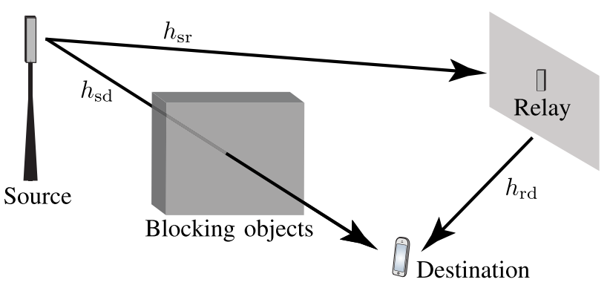
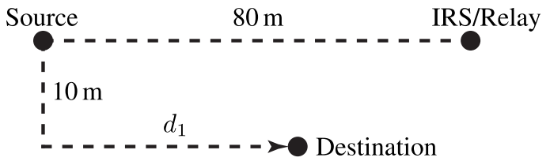
System model and simulation setup
1. An IRS with N discrete elements, and assume each has the same size as the relay’s antenna.
2. A classic repetition-coded DF relaying protocol.
3. Distance d1 is a variable
3
Notes:
右上圖 是由N個被動元件組成的智能反射板 IRS with N discrete elements
the source and IRS/relay are deployed at fixed locations, while the location of the destination is determined by the variable d1

Slide 5
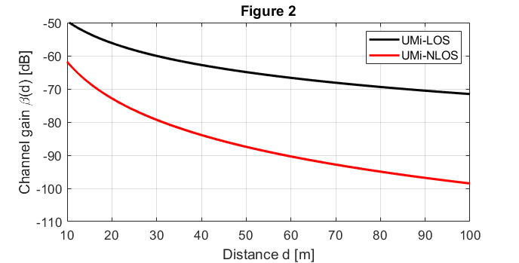
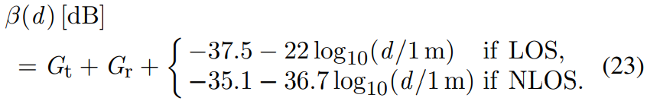
Theoretical curve of the channel gains [3]
– A “large” channel gain in
wireless communications
is -60 dB
[3] Further Advancements for E-UTRA Physical Layer Aspects (Release 9), 3GPP Standard TS 36.814, Mar. 2010.
4
Notes:
依照TS 36.814文件的設定 且忽略 shadow fading 會得到一個 deterministic model 然後把 channel gain β 畫成對距離d的函數
如果 source到destination 的channel gain β_sd > IRS / relay到destination 的channel gain β_rd 也就是有LOS的時候 其實SISO就夠了((當然
一個看起來很小的數字 如−60 dB 其實是超級大的channel gain, 正常的數值會落在−70 ~ −110 dB
distance從10開始到100是因為 3GPP Urban Micro (UMi) model 考慮的設定是10~500公尺

Slide 6
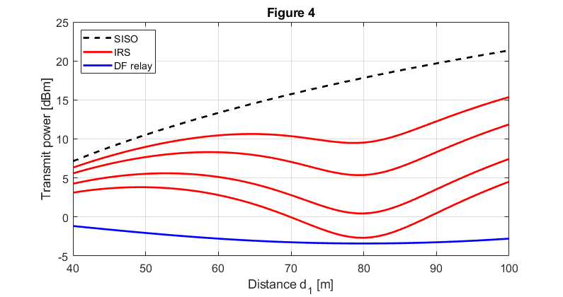
SISO vs. IRS (N=25, 50, 100, 150) vs. DF relaying
– The transmit power needed to achieve a rate of 4 bit/s/Hz
– N > 164 is needed to outperform DF relaying when d1 = 80 m
5
Notes:
利用(23)式 去計算對應距離的channel gain
transmit power that is needed to achieve a rate of either R¯ = 4 bit/s/Hz, bandwidth is B = 10 MHz, the noise power is −94 dBm

Slide 7
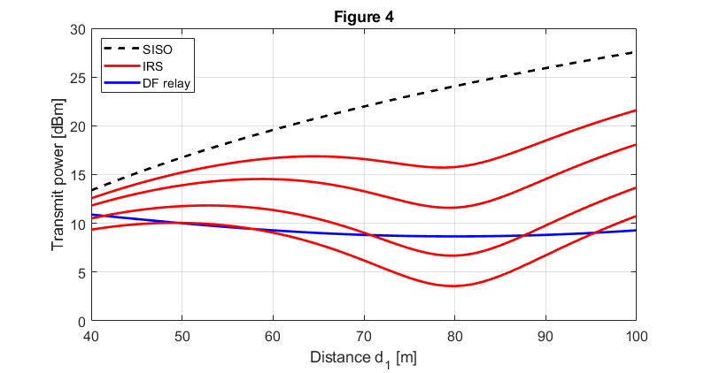
SISO vs. IRS (N=25, 50, 100, 150) vs. DF relaying
– The transmit power needed to achieve a rate of 6 bit/s/Hz
– “Only” N > 76 is needed to outperform relaying when d1 = 80 m
6
Notes:
利用(23)式 去計算對應距離的channel gain
transmit power that is needed to achieve a rate of either R¯ = 6 bit/s/Hz, bandwidth is B = 10 MHz, the noise power is −94 dBm
required power grows more rapidly with R¯ with relaying due to the 1/2-prelog penalty

Slide 8
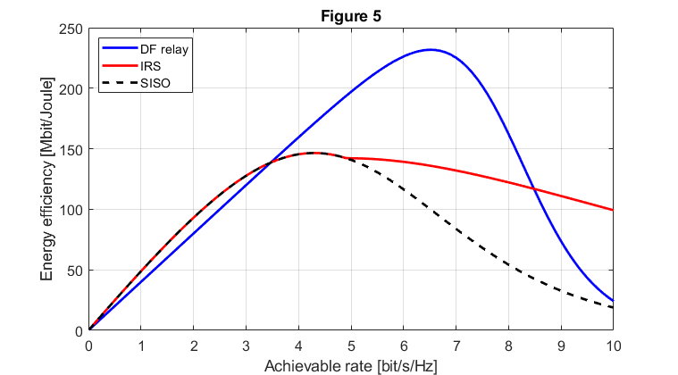
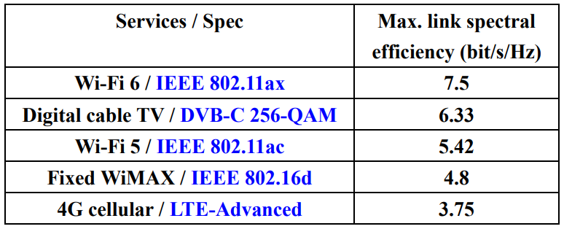
Energy efficiency (EE)
– Switching between SISO and DF relaying is better both in terms of minimizing
Tx power and maximizing EE, except for very high rates situations
7
Notes:
SISO在rate介於 0~3.47 間 有最好的能源效率 R¯ ∈ (0, 3.47] bit/s/Hz
DF relaying在rate介於3.47~8.48間 有最好的能源效率 R¯ ∈ (3.47, 8.48] bit/s/Hz.
而rate小於4.9 bit/s/Hz IRS所需的N不存在的 因為所需的N都小於0 當rate大於 8.48的時候 R¯ > 8.48 bit/s/Hz IRS才能有比DF更好的能源效率

